Slide 1
Practices + Mindsets of Creative Processes
Session 1: Knowing Your Students and Your Role.
  Reflection + Interviewing:
    Whom do I serve? What’s my role?
Session 2: Envisioning and Experimenting
  Think Big:
    How might we address the needs we have defined?
  Start Small:
    What are small experiments we can run before committing fully?
OUR SHARED WORK
Notes:
There are specific problems that are a great match for design thinking, and we call them “wicked problems”. (Note: This is a term from the world of software design that describes complex problem.)
These problems are ambiguous; there is no manual or formula for how to solve it. These problems are unique to you and have many nuances. Sometimes even as you work on the problem, it changes as you dig into the root cause. Problems like how to have a thriving career, balancing competing priorities, growing the love relationships you desire, and dealing with illness can all become wicked problems.

Slide 2
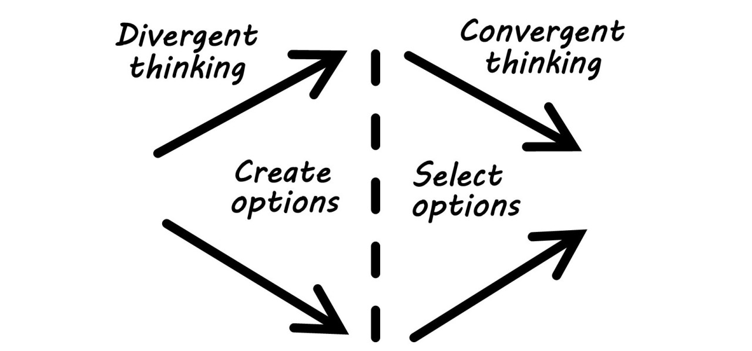
DESIGNING FOR THE UNKNOWN …

Slide 3






DESIGN THINKING
Mindsets and practices
MINDFULNESS OF PROCESS
REFRAMING
STORYTELL
CURIOSITY
BIAS TOWARD
ACTION
RADICAL COLLABORATION

Slide 4
HELPFUL MINDSETS AND PRACTICES
On a post-it note,
please choose and write down:
- one that you find most easy or intuitive to use.
- one that you want to lean more heavily into using.
MINDFULNESS OF PROCESS
REFRAMING
STORYTELLING
CURIOSITY
BIAS TOWARD
ACTION
RADICAL COLLABORATION

Slide 5
Reflection + Conversation
With your partner, share:
What mindset / practice do you find most easy to access?
What mindset / practice might you practice using more often?

Slide 6
Let’s start with understanding our students and our roles.

Slide 7
DESIGNING FOR WELL-BEING:
Speaker Notes and Noticings
What do I believe my students need? How do I feel when I bring my students to mind?
What mindsets and beliefs might I want to encourage in my students?
What mindsets and beliefs might I want to shift in my students?
What does my role allow me to do now? What do I want or need in order to do my work?
What do I hope and wish for?
Exercise 1: Individual reflection →
Take a few minutes to jot down your initial thoughts.
Use only the left-side column.
Before we begin:
You will share what you feel comfortable sharing, but your writing will be yours to keep privately.

Slide 8
Before we begin:
1) Don’t stress too much. Just note what you observe.
2) Some wording suggestions to go deeper, if a pause invites it.
Tell me more…
Can you say more about that?
Paint me a picture.
Tell me a quick story about that.
3) Listening:
Listen to absorb and then reflect. Do not listen to connect.
Exercise 2: Paired interviews
About 8 minutes per round before you switch. Shortest sleeves goes first!
Remember that you can do this at home.
Instructions:
1) Speaker: Share your answers to the questions. Only what you feel comfortable sharing!
Listener: Use the Empathy Map to make observations.
2) Stop when you hear my signal.
3) Listeners, share those observations.
Speakers, make any notes in the “interview notes” column.
THINKING
What does the person think and how might their thoughts motivate their behavior?
What are their goals and areas of frustration?
FEELING
What does the person feel and how might their feelings motivate their behavior?
What are their hopes, dreams, fears and concerns?
HEARING
What does the person hear from their students? colleagues? campus partners? external sources (media, research, other)?
DOING
What does the person do now? What possibilities might we imagine them doing in the future?
SAYING
What do we hear the person saying?
What might we imagine them saying in the future?

Slide 9
DESIGNING FOR WELL-BEING: Interviewer Empathy Map
FEELING
What does the person feel and how might their feelings motivate their behavior?
What are their hopes, dreams, fears and concerns?
THINKING
What does the person think and how might their thoughts motivate their behavior? What are their goals and areas of frustration?
HEARING
What does the person hear from their students? colleagues?
campus partners? external sources (media, research, other)?
Tell me more…
Can you say more about that?
Paint me a picture.
Tell me a quick story.
SAYING
What do we hear the person saying?
What might we imagine them saying in the future?
DOING
What does the person do now? What possibilities might we imagine them doing in the future?

Slide 10

BEFORE WE MEET AGAIN ... →

Slide 11





DESIGNING FOR WELL-BEING: Think Big, Start Small
FUTURE PLANNING
RESOURCES
STAKEHOLDERS
GROWTH TIMELINE
FINANCIAL RESOURCES
PRIMARY USERS
Where are we headed when?
Where might funding come from?
Who are your students? Define them here.
INDIVIDUAL REFLECTION.
Throughout the day, take notes here if something captures your attention.
EASY EXPERIMENTS
ENVIRONMENTAL RESOURCES
OTHER STAKEHOLDERS
What are 3 things we can try in 3-6 months?
What action is easy to take quickly?
What space needs might we have? How might we (need to) use virtual space?
Are there other constituencies implicated in your work?
BARRIERS + CHALLENGES
FUTURE VISION
PEOPLE + PROGRAM PARTNERS?
What’s likely to get in the way? How might we address these?
In 25 years, we imagine an institution where…
Who is already doing this work? How might we learn from, work with or recruit them?

Slide 12
SEE YOU LATER!

