Slide 1
Practices + Mindsets of Creative Processes
Session 1: Knowing Your Students and Your Role.
  Reflection + Interviewing:
    Whom do I serve? What’s my role?
Session 2: Envisioning and Experimenting
  Think Big:
    How might we address the needs we have defined?
  Start Small:
    What are small experiments we can run before committing fully?
OUR SHARED WORK
Notes:
There are specific problems that are a great match for design thinking, and we call them “wicked problems”. (Note: This is a term from the world of software design that describes complex problem.)
These problems are ambiguous; there is no manual or formula for how to solve it. These problems are unique to you and have many nuances. Sometimes even as you work on the problem, it changes as you dig into the root cause. Problems like how to have a thriving career, balancing competing priorities, growing the love relationships you desire, and dealing with illness can all become wicked problems.

Slide 2


SESSION 2:
DIVERGING IDEAS AND CONVERGING EXPERIMENTS

Slide 3

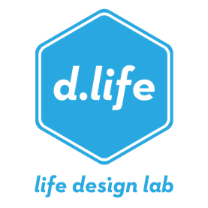
“HOW MANY USES?”
Get out your notebook and a pen/pencil.
List all the things you can use a paper clip for.
Go for as many ideas as you possibly can.
You have about 1 minute.
Notes:
Overview: Instruction slide
As you click through each bullet point, read instructions as is, being deliberately brief and purposefully setting up the “holding something together” schema.
[click to next slide]

Slide 4
GO!
Notes:
Overview: Working time. Slide music = flight of the bumblebee (deliberately stress-inducing music) during which we are setting up the feeling of stuckness.
music times the exercise…..
[note from Sp22: students have been more vocal over the course of the year about the music being more than stress-inducing, but it being distressing. Explore a different type of song that has the same effect but with less intensity.]

Slide 5

Notes:
Alright, pens and pencils down. Let’s debrief this design exercise together.

Slide 6
DEBRIEF
What did that feel like?
How many uses did you come up with?
Did anyone get unstuck, have a breakthrough moment?
Notes:
Overview: Debrief of the experience, especially emphasizing the felt experience of being stuck.
Lead a debrief of the experience:
What did that feel like?
[Facilitator reflects trends back to the group, emphasizing any experiences of getting stuck. Comment on the purposeful choice of music to induce stress, and thus, “stuckedness.” Call on 1-2 students to say more.]
How many uses did you come up with?
[Facilitator asks for at least 2 volunteers who generated lots of ideas to share a) their strategies, highlighting and underscoring the different aspects that cultivate effective ideation. Ex. Some people need to move around, others benefit from holding a real paper clip and manipulating it, others ask themselves: what is an unconventional way for me to use a paperclip, etc. ]
Also, fun to ask these volunteers for their wildest idea.
Were you ever frustrated or stuck? What did that feel like?
[Facilitator reflects trends back to the group, emphasizing any experiences of getting stuck.]
It’s important to highlight where they feel it in their bodies, pointing out that often the body tells us we’re stuck before we realize it cognitively, and so paying attention to our bodies can yield good data.
Did anyone get unstuck? Like you hit a wall and couldn’t come up with ideas, and then all of a sudden a light bulb went off and a new slew of ideas came pouring out?
Call on at least 2 students providing generative affirmation and reflecting for the group strategies for getting unstuck.

Slide 7
SCHEMAS
Notes:
Purpose: To introduce the concepts of divergent and convergent thinking, and connect the skill of divergent thinking to the ability to access different schemas, and thus, different types of ideas.
What you may be noticing is how whatever schema you are working with, whether implicit or explicit, ends up influencing the kinds of ideas you are able to generate, and potentially, the number of ideas you come up with.
[click]
I suspect there’s a schema many of you may have been working with but weren’t aware of consciously. Did anyone work together? Or use Google search?
(Usually not) Why not? Right! That would be cheating!! We’re in an academic environment, that’s not allowed! That was a rule you MADE UP for this design exercise. Nothing in the rules stated you couldn’t. What’s interesting to note here is how setting, cultural or societal norms, and other factors can affect the implicit schemas we bring to bear on questions and problems.
The good news is that this is a different kind of class where we explicitly encourage radical collaboratioin. And we are going to be really thinking about how we define the problems we tackle.
So what does this experience of getting stuck and unstuck, and this concept of schemas, have to do with Life Design?
[long pause to let question land]
There’s an old saying “When all you have is a hammer, every problem looks like a nail”. It’s really hard to take a screw out of a wall with a hammer. It’s much better to use a screwdriver. So, if you can be aware of your schemas, you can interrogate them and intentionally take a different POV, allowing you access to a broader set of ideas from which to design.
[click] There’s a concept called “Divergent Thinking.”
Proposed by the mid-twentieth century psychologist JP Guilford, Divergent Thinking is the ability to generate many ideas or solutions from a single idea or piece of information. It’s thought to be one of, if not the most, important factor in creativity.
And yet, it’s a mostly ignored skill. In school and most workplaces, we’re taught and encouraged primarily to practice Convergent Thinking, which is the ability to take many pieces of information or data and generate one solution. Think of solving a math equation with many variables or generating a report and action plan for your consulting client.
Most of us get lots of training and practice in Convergent Thinking, which make no mistake, is important. But many of us get very little training in Divergent Thinking.
So, if you want to get good at adopting multiple schemas to help you to access a broader set of ideas from which to design, practice exercising your Divergent Thinking muscles. One way to do this is in your every day life is, when presented with some decision you have to generate options for, always shoot for at least three options before moving forward.
We hope that, over the course of this class, you get good at Divergent Thinking, at generating ideas for your life, voluminous ideas that are widely varied so the choices you end up making come from a broader set of possibilities.

Slide 8
SCHEMA THEORY
Notes:
Purpose: To introduce the concepts of divergent and convergent thinking, and connect the skill of divergent thinking to the ability to access different schemas, and thus, different types of ideas.
What you may be noticing is how whatever schema you are working with, whether implicit or explicit, ends up influencing the kinds of ideas you are able to generate, and potentially, the number of ideas you come up with.
[click]
I suspect there’s a schema many of you may have been working with but weren’t aware of consciously. Did anyone work together? Or use Google search?
(Usually not) Why not? Right! That would be cheating!! We’re in an academic environment, that’s not allowed! That was a rule you MADE UP for this design exercise. Nothing in the rules stated you couldn’t. What’s interesting to note here is how setting, cultural or societal norms, and other factors can affect the implicit schemas we bring to bear on questions and problems.
The good news is that this is a different kind of class where we explicitly encourage radical collaboratioin. And we are going to be really thinking about how we define the problems we tackle.
So what does this experience of getting stuck and unstuck, and this concept of schemas, have to do with Life Design?
[long pause to let question land]
There’s an old saying “When all you have is a hammer, every problem looks like a nail”. It’s really hard to take a screw out of a wall with a hammer. It’s much better to use a screwdriver. So, if you can be aware of your schemas, you can interrogate them and intentionally take a different POV, allowing you access to a broader set of ideas from which to design.
[click] There’s a concept called “Divergent Thinking.”
Proposed by the mid-twentieth century psychologist JP Guilford, Divergent Thinking is the ability to generate many ideas or solutions from a single idea or piece of information. It’s thought to be one of, if not the most, important factor in creativity.
And yet, it’s a mostly ignored skill. In school and most workplaces, we’re taught and encouraged primarily to practice Convergent Thinking, which is the ability to take many pieces of information or data and generate one solution. Think of solving a math equation with many variables or generating a report and action plan for your consulting client.
Most of us get lots of training and practice in Convergent Thinking, which make no mistake, is important. But many of us get very little training in Divergent Thinking.
So, if you want to get good at adopting multiple schemas to help you to access a broader set of ideas from which to design, practice exercising your Divergent Thinking muscles. One way to do this is in your every day life is, when presented with some decision you have to generate options for, always shoot for at least three options before moving forward.
We hope that, over the course of this class, you get good at Divergent Thinking, at generating ideas for your life, voluminous ideas that are widely varied so the choices you end up making come from a broader set of possibilities.

Slide 9
SCHEMA THEORY
Notes:
Purpose: To introduce the concepts of divergent and convergent thinking, and connect the skill of divergent thinking to the ability to access different schemas, and thus, different types of ideas.
What you may be noticing is how whatever schema you are working with, whether implicit or explicit, ends up influencing the kinds of ideas you are able to generate, and potentially, the number of ideas you come up with.
[click]
I suspect there’s a schema many of you may have been working with but weren’t aware of consciously. Did anyone work together? Or use Google search?
(Usually not) Why not? Right! That would be cheating!! We’re in an academic environment, that’s not allowed! That was a rule you MADE UP for this design exercise. Nothing in the rules stated you couldn’t. What’s interesting to note here is how setting, cultural or societal norms, and other factors can affect the implicit schemas we bring to bear on questions and problems.
The good news is that this is a different kind of class where we explicitly encourage radical collaboratioin. And we are going to be really thinking about how we define the problems we tackle.
So what does this experience of getting stuck and unstuck, and this concept of schemas, have to do with Life Design?
[long pause to let question land]
There’s an old saying “When all you have is a hammer, every problem looks like a nail”. It’s really hard to take a screw out of a wall with a hammer. It’s much better to use a screwdriver. So, if you can be aware of your schemas, you can interrogate them and intentionally take a different POV, allowing you access to a broader set of ideas from which to design.
[click] There’s a concept called “Divergent Thinking.”
Proposed by the mid-twentieth century psychologist JP Guilford, Divergent Thinking is the ability to generate many ideas or solutions from a single idea or piece of information. It’s thought to be one of, if not the most, important factor in creativity.
And yet, it’s a mostly ignored skill. In school and most workplaces, we’re taught and encouraged primarily to practice Convergent Thinking, which is the ability to take many pieces of information or data and generate one solution. Think of solving a math equation with many variables or generating a report and action plan for your consulting client.
Most of us get lots of training and practice in Convergent Thinking, which make no mistake, is important. But many of us get very little training in Divergent Thinking.
So, if you want to get good at adopting multiple schemas to help you to access a broader set of ideas from which to design, practice exercising your Divergent Thinking muscles. One way to do this is in your every day life is, when presented with some decision you have to generate options for, always shoot for at least three options before moving forward.
We hope that, over the course of this class, you get good at Divergent Thinking, at generating ideas for your life, voluminous ideas that are widely varied so the choices you end up making come from a broader set of possibilities.

Slide 10
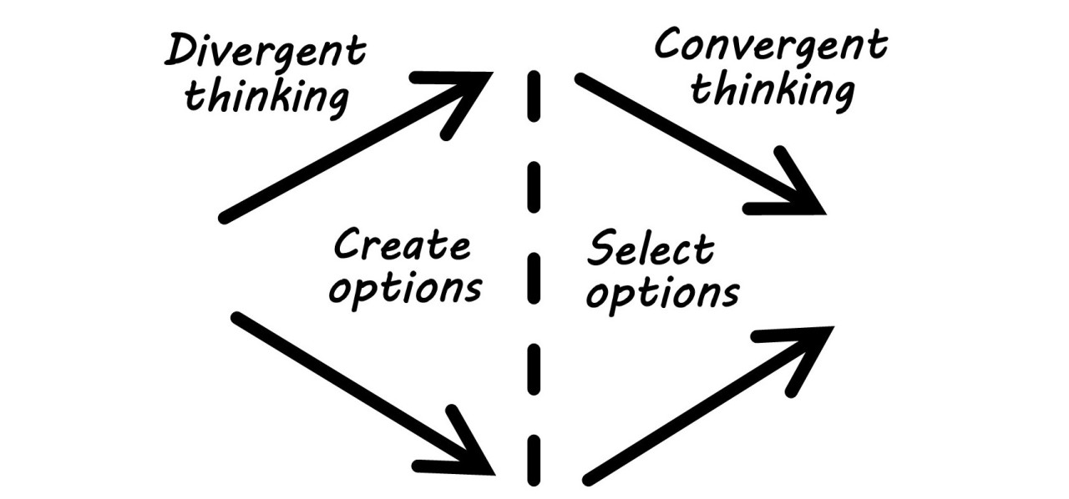
SCHEMAS
Notes:
Purpose: To introduce the concept of schemas, and to begin exploring how schemas influence the ideas accessible to us.
It turns out your brain is a 40 watt processor, which is not that powerful. However, it makes up for this by organizing data in the environment hierarchically in what cognitive psychologists call schemas. It’s our brain’s attempt at efficiency in interpreting the vast amounts of information it’s presented with in the world.
Here’s a secret: I primed you for a certain schema, and thus, pathway of ideas, when I showed you the paper clip doing it’s typical function... holding sheets of paper together. [click]
And so perhaps, you started out with ideas in the “holding things together” schema:
[click] holding gift wrapping paper,
[click] or a bag of popcorn closed,
[click] or displaying photo prints in your room, or, if your creative juices were flowing,
[click] using it to hold up your phone.

Slide 11
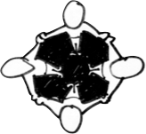
Did you ask for help?
RADICAL COLLABORATION
Notes:
Purpose: To introduce the concept of schemas, and to begin exploring how schemas influence the ideas accessible to us.
It turns out your brain is a 40 watt processor, which is not that powerful. However, it makes up for this by organizing data in the environment hierarchically in what cognitive psychologists call schemas. It’s our brain’s attempt at efficiency in interpreting the vast amounts of information it’s presented with in the world.
Here’s a secret: I primed you for a certain schema, and thus, pathway of ideas, when I showed you the paper clip doing it’s typical function... holding sheets of paper together. [click]
And so perhaps, you started out with ideas in the “holding things together” schema:
[click] holding gift wrapping paper,
[click] or a bag of popcorn closed,
[click] or displaying photo prints in your room, or, if your creative juices were flowing,
[click] using it to hold up your phone.

Slide 12
GO AGAIN!
Notes:
Overview: Working slide where students are re-doing the exercise with greater confidence
Go for volume, cleverness. Break the rules. And when you get stuck this time, instead of going numb, take a breath. When you have an aha moment, push it.
Relaxing music – no coaching, or if you do, be positive and mellow.

Slide 13
“HOW MANY USES?”
Get out your notebook and a pen/pencil.
List all the things you can use a paper clip for.
Go for as many ideas as you possibly can.
You have 2 minutes.
Notes:
Overview: Instruction slide
As you click through each bullet point, read instructions as is, being deliberately brief and purposefully setting up the “holding something together” schema.
[click to next slide]

Slide 14
Notes:
Alright, pens and pencils down. Let’s debrief this design exercise together.

Slide 15

WHAT HAPPENED?
Changing environmental factors can impact our ability and flexibility to access different schemas.
When we broaden our schemas, we broaden our solution set.
When we seek new perspectives, we often get new ideas.
We all get stuck. To get unstuck, we must discern between what is in our control and what is not.
Notes:
Purpose: Takeaways
Read slide

Slide 16
IDEATING FOR DIVERGENT POSSIBILITES
Let’s see what happens when we generate wildly divergent paths.
Resist the temptation to judge these as you make these!
Notes:
OVERVIEW: Setting up Odyssey plans as a divergent thinking exercise, specifically blowing up that there is one best life.
Show the dysfunctional belief and reiterate that this kind of thinking is anxiety producing and keeps us stuck.
Click to show the reframe – there are many wonderful possibilities – seed of amazing lives – inside us.
What if there are many good ways forward?
----- OLD NOTES -----
Non-designers have a tendency to think there is only ONE (the right one, best one, the only one). Where Plan A is the really good plan, Plan B is your backup and Plan C is the plan you really don’t want but would accept as tolerable if absolutely necessary.
In design thinking, we use ideation to help us go for volume, because you choose better when you have lots of good ideas to choose from. If your mind starts with multiple ideas in parallel, it is not prematurely committed to one path and stays more open and able to receive and conceive more novel innovations. We want to ideate multiple variations in order to choose creatively and generatively.
In your odysseys, we want you to come up with three truly different alternatives – not three variations on a theme. Product management at Google, at Apple and at Slack are not really three alternatives, they are three versions of the same alternative. Try to come up with three really different ideas.

Slide 17
3 SCHEMAS.
Doodle three 5-year timelines.
Add space for a title.
Notes:
These slides and notes provide you the information that you need to prepare your Odyssey Plan.
If after reviewing all this material and having attended the preview discussion in class about this assignment, you still have questions. Do NOT hesitate to contact your Section Facilitator or Dave or Bill with your issues.
This is an important assignment and really serves as the synthesis of all your work this quarter so don’t leave it to the last moment or allow yourself to get unnecessarily stuck due to an ambiguity.

Slide 18
5 YEARS, 3 SCHEMAS.
MYSTERY!!!!
MYSTERY!!!!
Path #1:
Things just go so well with well-being efforts! A+!

Slide 19
5 YEARS, 3 SCHEMAS.
Quickly add some milestones, anywhere on the timline, in different categories. Curriculum, services, new construction, technology, community programs, whatever!
Take any idea and ask, “If that happens, then what might happen next?” Challenge yourself to accept the idea, and say “yes, and” to generate the next idea from there.
Notes:
These slides and notes provide you the information that you need to prepare your Odyssey Plan.
If after reviewing all this material and having attended the preview discussion in class about this assignment, you still have questions. Do NOT hesitate to contact your Section Facilitator or Dave or Bill with your issues.
This is an important assignment and really serves as the synthesis of all your work this quarter so don’t leave it to the last moment or allow yourself to get unnecessarily stuck due to an ambiguity.

Slide 20
5 YEARS, 3 SCHEMAS.
Path #2:
Think of a core characteristic of your institution, something endemic to the culture, reputation, or student experience. Now take it away.
Path #1:
Things just go so well with well-being efforts! A+!

Slide 21
Notes:
Purpose: To introduce the concepts of divergent and convergent thinking, and connect the skill of divergent thinking to the ability to access different schemas, and thus, different types of ideas.
What you may be noticing is how whatever schema you are working with, whether implicit or explicit, ends up influencing the kinds of ideas you are able to generate, and potentially, the number of ideas you come up with.
[click]
I suspect there’s a schema many of you may have been working with but weren’t aware of consciously. Did anyone work together? Or use Google search?
(Usually not) Why not? Right! That would be cheating!! We’re in an academic environment, that’s not allowed! That was a rule you MADE UP for this design exercise. Nothing in the rules stated you couldn’t. What’s interesting to note here is how setting, cultural or societal norms, and other factors can affect the implicit schemas we bring to bear on questions and problems.
The good news is that this is a different kind of class where we explicitly encourage radical collaboratioin. And we are going to be really thinking about how we define the problems we tackle.
So what does this experience of getting stuck and unstuck, and this concept of schemas, have to do with Life Design?
[long pause to let question land]
There’s an old saying “When all you have is a hammer, every problem looks like a nail”. It’s really hard to take a screw out of a wall with a hammer. It’s much better to use a screwdriver. So, if you can be aware of your schemas, you can interrogate them and intentionally take a different POV, allowing you access to a broader set of ideas from which to design.
[click] There’s a concept called “Divergent Thinking.”
Proposed by the mid-twentieth century psychologist JP Guilford, Divergent Thinking is the ability to generate many ideas or solutions from a single idea or piece of information. It’s thought to be one of, if not the most, important factor in creativity.
And yet, it’s a mostly ignored skill. In school and most workplaces, we’re taught and encouraged primarily to practice Convergent Thinking, which is the ability to take many pieces of information or data and generate one solution. Think of solving a math equation with many variables or generating a report and action plan for your consulting client.
Most of us get lots of training and practice in Convergent Thinking, which make no mistake, is important. But many of us get very little training in Divergent Thinking.
So, if you want to get good at adopting multiple schemas to help you to access a broader set of ideas from which to design, practice exercising your Divergent Thinking muscles. One way to do this is in your every day life is, when presented with some decision you have to generate options for, always shoot for at least three options before moving forward.
We hope that, over the course of this class, you get good at Divergent Thinking, at generating ideas for your life, voluminous ideas that are widely varied so the choices you end up making come from a broader set of possibilities.

Slide 22




WHY WILD IDEAS?
Notes:
Purpose: to illustrate why Wild Ideas are helpful
[talk track refreshed by Christian Simamora Fall 2022]
We are trying to solve a problem.
[click] –
and we’re coming up with ideas but they all are in the current schema of how we are approaching the problem.
And we’re stuck.
And by definition, if that’s the case, we need to adopt a new schema.
[click] -
Inevitably, thinking outside the box comes up as a strategy.
And there it is, our outside-the-box idea.

Slide 23
WHY WILD IDEAS?
BUT OUR ASSUMPTIONS ARE TOO STRONG!
And it ends up back “inside the box.”
Notes:
Purpose: to illustrate why Wild Ideas are helpful
[talk track refreshed by Christian Simamora Fall 2022]
But, our current schema and its assumptions are too strong at times.
[click] –
And we modify the idea until it looks like all of the other ideas in our current set. It’s back “inside the box.” Meaning, we’ve made no break through and are still looking at our problem through the same lens.

Slide 24

WHY WILD IDEAS?
We have to go so far that we break our assumptions!
Notes:
Purpose: to illustrate why Wild Ideas are helpful
[talk track refreshed by Christian Simamora Fall 2022]
That’s why we need an idea that is so far outside our current schema, that it breaks our assumptions of how we understand the problem in front of us.
[click to animate]

Slide 25
WHY WILD IDEAS?
Now we have fundamentally changed our solution space.
Maybe we have to modify it during implementation – but we are now working with new insights!
Notes:
Purpose: to illustrate why Wild Ideas are helpful
[talk track refreshed by Christian Simamora Fall 2022]
Once we’ve done that, we’ve fundamentally changed the solution space.
It’s true, that once we get to implementation, we may have to modify our “wild idea.” But it’s already served its function of giving us new insights into our problem or question.

Slide 26

WARM UP:
POINT AND SHOUT!

Slide 27
5 YEARS, 3 SCHEMAS.
Path #2:
Think of a core characteristic of your institution, something endemic to the culture, reputation, or student experience. Now take it away.
Path #1:
Things just go so well with well-being efforts! A+!
Is there something getting in the way of well-being?

Slide 28
5 YEARS, 3 SCHEMAS.
Path #2:
Think of a core characteristic of your institution, something endemic to the culture, reputation, or student experience. Now take it away.
Path #3:
Release constraints!
What are 2 major barriers to this work? What if they JUST NOW resolved or disappeared?
Path #1:
Things just go so well with well-being efforts! A+ job!
Feel free to consider external factors or internal stuck points.

Slide 29

SHARING OUR WORK
      Find a NEW partner.
      Introduce yourselves.
      Once you are settled:
      Each person will share:
        What the process was like
        What surprised you, if anything
        Any noticings about differences or similarities between paths
        Anything else that comes to mind!
      Switch speakers.
      BONUS IDEA: Don’t forget to thank your first partner and share any connections you made between session 1 + 2.

Slide 30
MAKE A PROTOTYPE.
      Identify a few ideas that you find delightful. Find a label. Mark with a “D.”
      Identify a few ideas that you find uncomfortable. Find a label. Mark with a “U.”
      Choose one from each category, and then generate one actionable thing you could do in the next 3 months.
      While designing the action, ask yourself:
        What is it you want to learn?

Slide 31

THINK BIG, START SMALL.

Slide 32

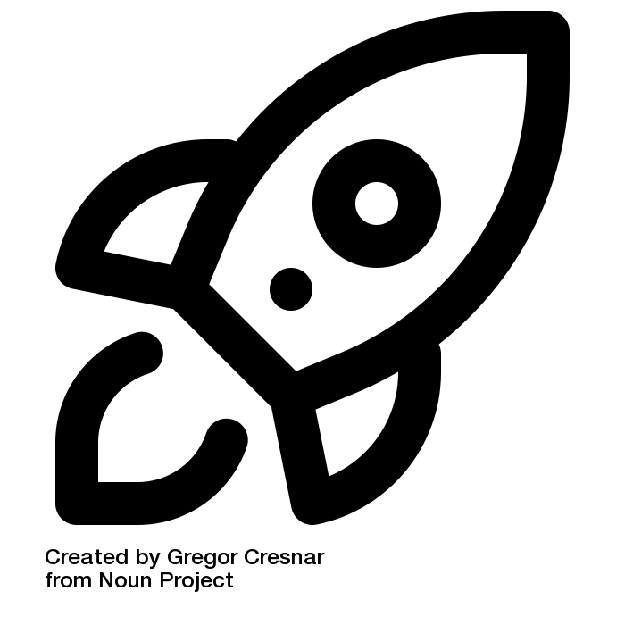
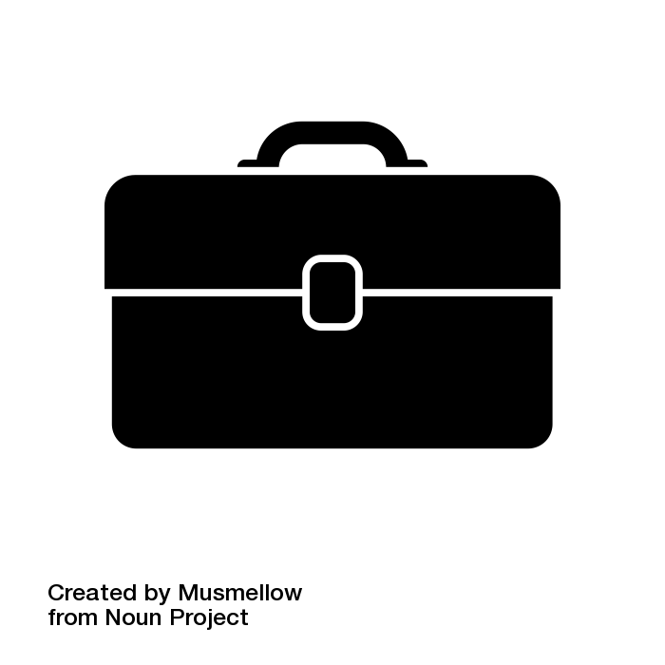
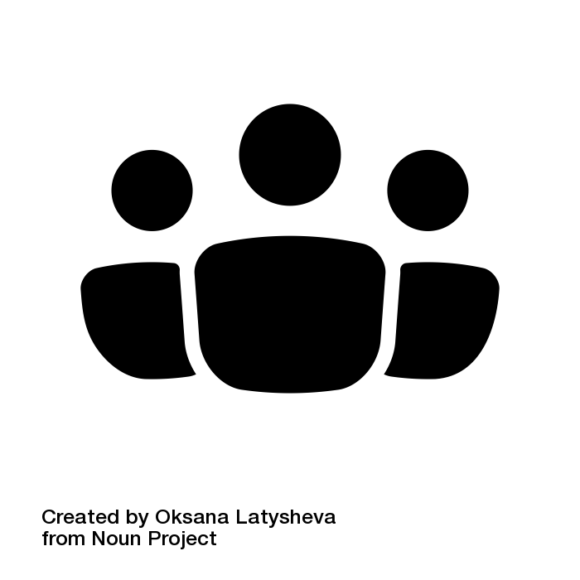

DESIGNING FOR WELL-BEING: Think Big, Start Small
FUTURE PLANNING
RESOURCES
STAKEHOLDERS
GROWTH TIMELINE
FINANCIAL RESOURCES
PRIMARY USERS
Where are we headed when?
Where might funding come from?
Who are your students? Define them here.
This year = humanities team uses in advising + programs
Year 3 = employer relations team uses life design for career fairs
Future = partnership with Provost Office!
Career center budget
New Student Orientation task force
Teaching and learning grant
Graduating seniors in humanities
- concerned about jobs prospects, need help naming skills
We may also add Masters students to our work
EASY EXPERIMENTS
ENVIRONMENTAL RESOURCES
OTHER STAKEHOLDERS
What are 3 things we can try in 3-6 months?
What action is easy to take quickly?
What space needs might we have? How might we (need to) use virtual space?
Are there other constituencies implicated in your work?
Use decision matrix in drop-in advising hours
Do rapid Odyssey ideation exercise with our student workers
Integrate design thinking into our interviewing workshop
Library building
New innovation space in Education School
Zoom?
College of Humanities/Sciences
Dean Jones and
VP of Student Life
BARRIERS + CHALLENGES
FUTURE VISION
PEOPLE + PROGRAM PARTNERS?
What’s likely to get in the way? How might we address these?
In 25 years, we imagine an institution where…
Who is already doing this work? How might we learn from, work with or recruit them?
Students pursue the humanities with confidence that they CAN get a job!
Leadership gives enough resources to student-centered initiatives in addition to research
Maybe School of Ed ed tech program?
Social impact student group – Spring alumni career mixer
The people in my Studio prototype group
Low funds – just enough for snacks right now
Need to pitch Dean Jones – she still isn’t sure whether to support
Competition for limited number of spaces

Slide 33
INDIVIDUAL WORK TIME
DESIGNING FOR WELL-BEING: Think Big, Start Small
FUTURE PLANNING
RESOURCES
STAKEHOLDERS
GROWTH TIMELINE
FINANCIAL RESOURCES
PRIMARY USERS
Where are we headed when?
Where might funding come from?
Who are your students? Define them here.
Capture initial thoughts over the next few minutes.
EASY EXPERIMENTS
ENVIRONMENTAL RESOURCES
OTHER STAKEHOLDERS
What are 3 things we can try in 3-6 months?
What action is easy to take quickly?
What space needs might we have? How might we (need to) use virtual space?
Are there other constituencies implicated in your work?
BARRIERS + CHALLENGES
FUTURE VISION
PEOPLE + PROGRAM PARTNERS?
What’s likely to get in the way? How might we address these?
In 25 years, we imagine an institution where…
Who is already doing this work? How might we learn from, work with or recruit them?

Slide 34
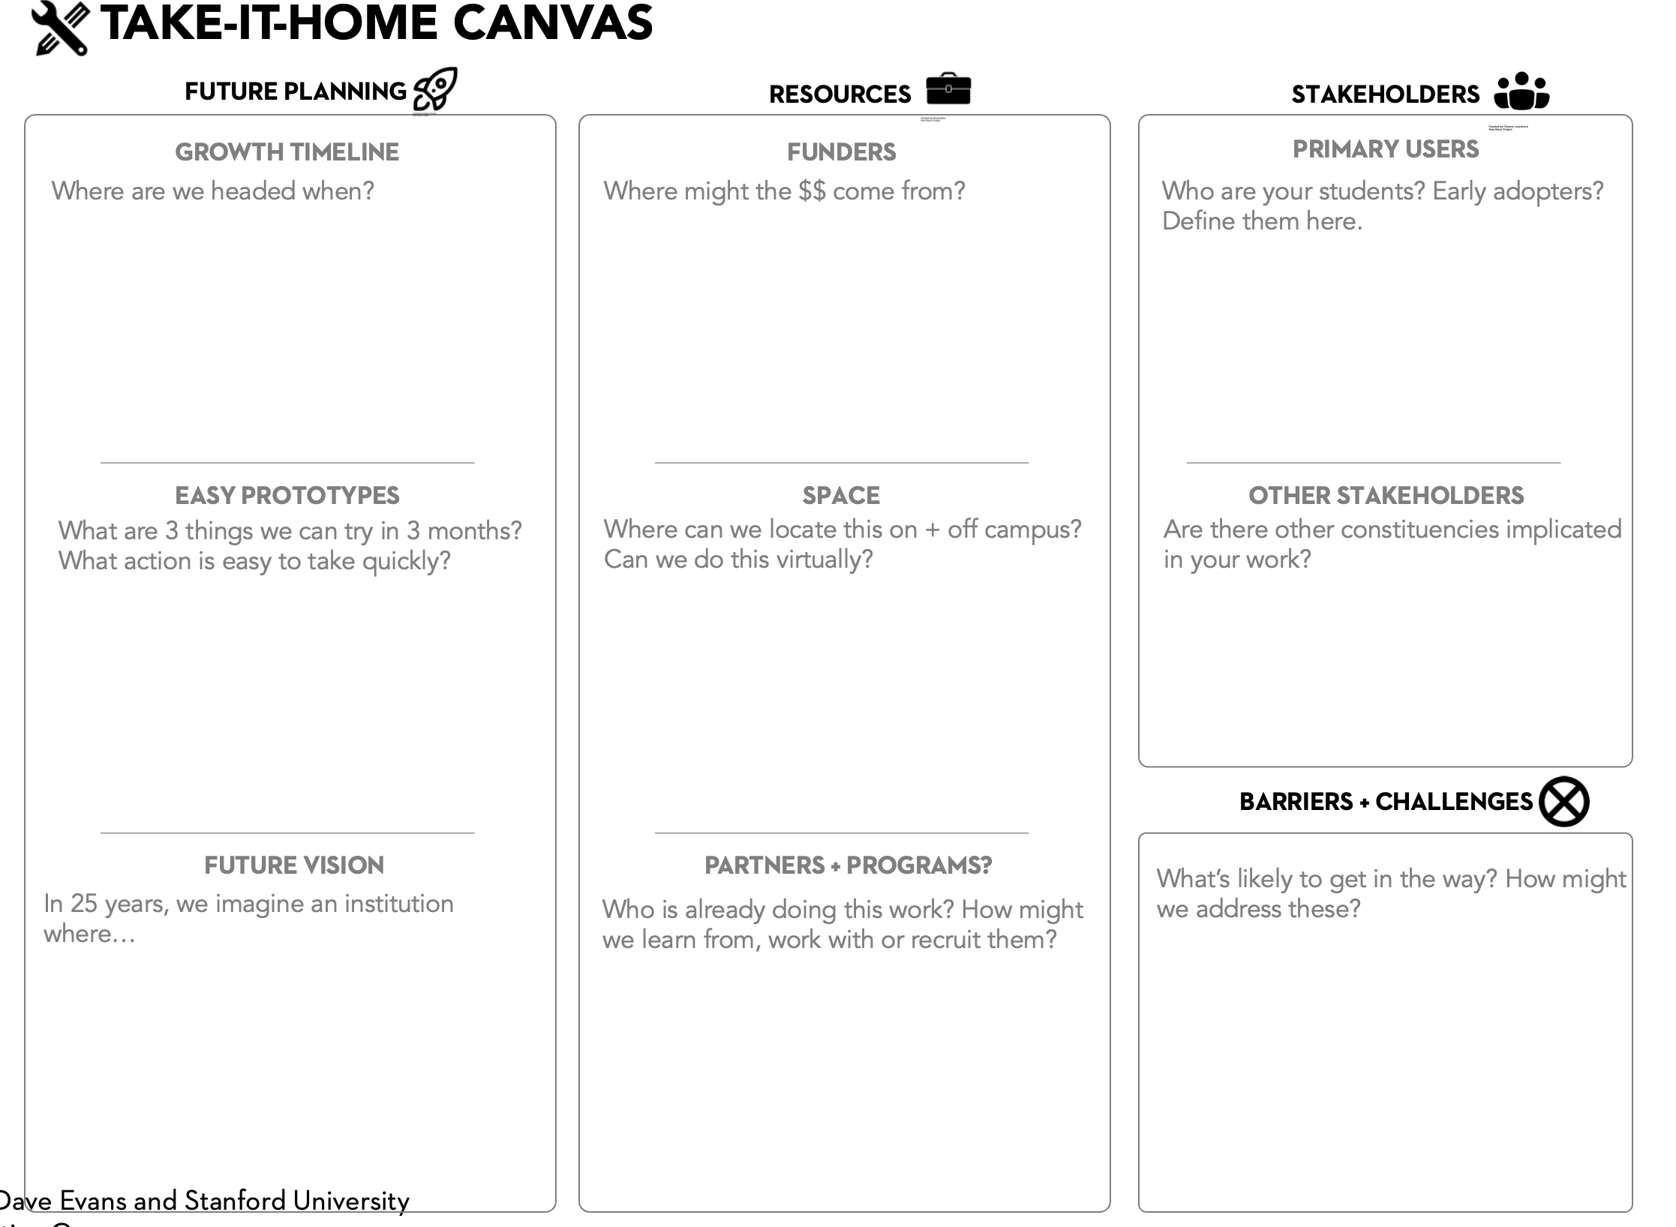
SHARING OUR WORK
In a small group of 2-3:
Each presenter: Share the highlights of your Canvas and any challenges you face.
AFTER everyone has gone:
As a group: Share thoughts about what this process was like for you.

Slide 35
DEBRIEF
      What themes and challenges came up in your groups?
      What intriguing ideas emerged about how to deal with those challenges?
      What did you get out of making your canvas?

Slide 36

STORYTELLING: A MINDSET AND PRACTICE
As you return to your institution:
How might the practice of storytelling support your work?
When might you use stories to get support for your work?
What is one story you have / have heard about your students that might move someone to action?

Slide 37

TRUSTING A CREATIVE PROCESS ….
Iterative, forgiving process that insists upon creating in the face of uncertainty.
Confronts a culture + context of urgency with strategically sound pauses
Invites agency and joy – even in the face of hard problems
Invites us to collaborate with others to build our way forward: Doing, Learning, Doing, Learning ….
Notes:
There are specific problems that are a great match for design thinking, and we call them “wicked problems”. (Note: This is a term from the world of software design that describes complex problem.)
These problems are ambiguous; there is no manual or formula for how to solve it. These problems are unique to you and have many nuances. Sometimes even as you work on the problem, it changes as you dig into the root cause. Problems like how to have a thriving career, balancing competing priorities, growing the love relationships you desire, and dealing with illness can all become wicked problems.

Slide 38

THANK YOU!
Notes:
USING BOTH HANDS, TRY TO HIGH-FIVE THE PEOPLE IN THE BOXES NEXT TO YOU.

